Slide 1

Jimmy Pitts
Period 6

Slide 2

  Who are the Indian People?
    Native inhabitants of the western hemisphere represent over 2000 cultures
    Possibly arrived via a land bridge
    Lived on the continent for centuries
  Migration from Asia
    Native Americans moved from Asia 25,000-30,000 years ago
    Asia and North America were connected by an ice-free, treeless grassland.
    This came to be known as Beringia deriving from the Bering Strait
    Summers were warm, winters were cold but snow free
    Created a good environment for a wide variety of animals such as bison, horse, camel, and saiga.
    Attracted nomadic bands of hunter-gatherers
    Today’s hunting-gathering people have a growth rate of only .5%
    Beringia became blocked through the later Ice Age by huge glaciers and rising seas (narrow parts of land did open up along the eastern basin of the Rocky Mountains.
    Migrants may have moved south in boats but many settled along the Great Plains
    Populated the entire Western Hemisphere in a few thousand years
    Many Indian stories depict stories of a long journey

Slide 3

  Clovis: The First American Technology
    Earliest tools: crude scrapers and choppers (usually made from stone or bone)
    Clovis Technology (more advanced) emerges
    More efficient way to feed expanding populations
    Clovis users=mobile people
The Beginning of Regional Cultures
  Hunting Traditions of the Plains and Forests
    15,000 years ago global warming trend changes climate
    Extinctions of 32 classes of New World animals
    New hunting techniques (refinement of Clovis tradition) develop Folsom points
    Growing complexity of Indian communities
    Passing of Pleistocene Epoch preceded by a wave of migrants known as the Athapascans (NaDene people) settled the forests of the northwest
  Desert Culture in Western America
    Pursuit of small game and intensified plant foraging
    Desert communities characterized by social equality
  Forest Efficiency
    Exploitation of diverse resources
    Settlements become increasingly permanent
    Burn woodlands to stimulate growth of berries, fruits, and edible roots

Slide 4
The Development Of Farming
  Mexico
    Cultivation began about 5000 years ago
    Maize and Potatoes (the “miracle crops”)
    Cultivation radically reshaped social life
    Appearances of villages and permanent architecture
    Division of labor leads to specialists (tool makers, craftsworkers, administrators, etc.)
    Emergence of classes
    New civilizations marked by warfare and sacrifice
Arrival of Europeans
  Indians exploited and used as slave labor
  Europeans bring spirits (increasing drunkenness among natives)
  Indians would often commit suicide rather than work as a slave (drank poison or hung themselves)
  Introduction of “old world” diseases such as small pox, warfare, famine, and lower birth rates ravaged the Native American population

Slide 5

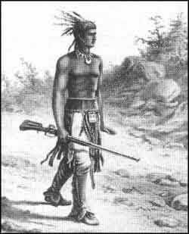
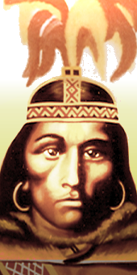
Squanto
  Kidnapped in 1614 by an English Captain
  Plague had wiped out his village of Patuxet
  Served as an interpreter between the pilgrims and the Massasoit Indians
  Taught colonists how to sow and cultivate corn (essentially to survive)
Chief Deganawida
  Iroquois
  Known as the “lawgiver”
  Founded the Iroquois confederacy
  Conflicts over territory led to violence and was these acts of violence were ended by the confederacy
  Established regulated forms of gift exchange and payment

Slide 6

Vocabulary Terms
Maize: Type of corn native to the Americas
Pueblos: Multi-storied apartment complexes often made from mud brick
Encomienda: Labor system employed by the Spanish (lord is given right to the labor of a community of Indians)
Kiva: Circular underground plaza
Seigneurs: Landlords (French)

Slide 7

What continent are Indians (Native Americans) believed to have originated from?
  Africa
  Asia
  Australia
  Europe
When is it believed that Indians first arrived in the Americas?
  50,000 years ago
  100,000-200,000 years ago
  25,000-30,0000 years ago
  5,000-10,000 years ago
What is considered the “miracle crop” and also served as a staple in the diet of Native Americans?
  Maize
  Rice
  Tobacco
  Cotton
What is the name of the land bridge that connected North America and Asia?
  Beringia
  The Indian Bridge
  Mesopotamia
  Alaska
What is Clovis technology?
  The first American technology
  Primitive tools (scrapers and choppers)
  The application of more efficient ways to feed expanding populations
  All of the above

Slide 8

What is forest efficiency?
  Exploitation of diverse natural resources
  A new way to grow forests
  The use of trees in daily life
  The method used to burn down forests
When is it believed farming first began in Mexico?
  1000 years ago
  2000 years ago
  5000 years ago
  10,000 years ago
What Native American tribe did Christopher Columbus mistake for Indians?
  Arawaks
  Cherokee
  Pilgrims
  Seminoles
What is a Pueblo?
  A Native American
  A housing structure similar to an apartment
  An underground complex
  Native American Tribe
What is the Iroquois Confederacy?
  A tribe of fighting Native Americans
  A reserve for Native Americans
  Trade between Europeans and Native Americans
  Laws set in order to end violence over disputed territory among Native Americans

Slide 9

1.B
2.C
3.A
4.A
5.D
6.A
7.C
8.A
9.B
10.D

Slide 10

Indian America was an important part of the Eighteenth century world
Although they were affected by the spread of colonial culture they remained in control of their lands (for now)
Native people along Atlantic coast begin to lose their lands to colonists through battles or treaties
  Moved into/beyond Appalachian Mountains
Become active in European trade (eventually becomes vital to life)
  Furs
  Firearms
  Metal tools
  Other manufactured goods
Iroquois Five Nations battle French and their Indian allies in King William’s war
  In 1701 sign treaty of neutrality
French have better relations with Indians than the English
In early 18th century, Indians blocked off French passage between the Great Lakes
  Attempt to become middlemen in the fur trade
  Eventually leads to fighting
  In 1738 French force Indians to sign a treaty
Colonists population expands and begins to move westward
1730/1740’s: Pennsylvania seizes western land from the Delawares
Population decline among Indians in North America
  Epidemics from European Diseases
Early 18th century Indians use horses stolen from Spanish
  Allow tribes to exploit buffalo herds more efficiently
  Allow the construction of nomadic culture
  Mounted plains Indians were a product of the colonial era

Slide 11

New Spain (considered today’s sunbelt of the U.S.) contained approximately 1 million Spanish colonists and nearly 2 million Indians
Florida: Fighting among Spanish, British, and Indians reduces colonial presence to St. Augustine and Pensacola
By mid-century, New Mexico includes about 20,000 Pueblo Indians
1716: French begin the construction of Franciscan missions among the Indian people of Texas
1690’s: Spanish establish Jesuit missions among the desert Indians of the lower Colorado
  For the Spanish, conquest demands for conversion
  Idea that they are leading Indians toward “civilization”
Indians constructed adobe and stone churches modeled after Spanish influence
Franciscan missionaries often resorted to violence to control their Indian subjects
  Shackles
  Solitary confinement
  Whipping posts
Indians would often retaliate
  Priests were killed, revolts/uprisings occurred, and many other villagers simply fled
The Seven Years War (French and Indian War)
  Ohio country is refuge for Indians who fled Northeast (Delawares, Shawnees, Hurons, Iroquois, and more)
  Most Ohio Indians opposed the British
  Anxious to preserve Appalachians as a barrier to westward expansion
  French outposts did not become centers of expanding agricultural settlements
  Iroquois confederacy maintained an official position of neutrality
    However, Iroquois factions join either British or French sides
    Sought to play one power against the other (to the Indians benefit)

Slide 12
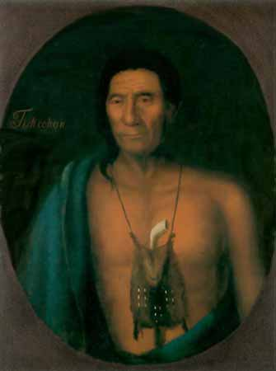
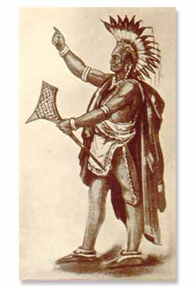
Chief Tishcohan (Delaware Indians)
  One of the leaders forced by Pennsylvania authorities to sign a fraudulent land deal
  Allowed authorities to unfairly distribute land among themselves (essentially without Indian consent)
  He later moved west to the Ohio River to avoid settlers as they encroached on his former homeland
Neolin (“The Enlightened One”)
  Known to English as the Delaware profit
  Taught that Indians had been corrupted by European ways (need to purify themselves)
    Return to traditions and prepare for a holy war
  Leads to a confederacy of tribes organized by chiefs

Slide 13
Vocabulary Terms
Mission: Religious centers created by Spanish, French, etc.
Adobe: Type of building material used by Indians (mud brick)
Ohio Country: refers to the trans-Appalachian region along the Ohio River
Stalemate: no winners (a tie)
Mestizo: Interracial offspring of Whites or Spanish with the Indian population

Slide 14

Multiple Choice
Indians were not important to the 18th century world
  True
  False
What did Indians gain from European trade?
  Furs
  Firearms
  Metal tools
  All of the above
What is a mission?
  An Indian goal
  A type of Native American tool
  A religious center
  A type of warfare
The French had better relations with Indians than the British
  True
  False
How did Indians first get horses?
  They were stolen from the Spanish
  They domesticated them from the wild
  They bought them from English merchants
  The Indians never had horses

Slide 15

What two missions survived fighting among British, Spanish, and Indians in Florida?
  San Francisco and Pueblo
  St. Augustine and Pensacola
  Jacksonville and St. Wilfred’s
  Salem and Plymouth
How did Franciscan Missionaries control Indians?
  Shackles
  By putting them in solitary confinement
  By whipping
  All of the above
Who was Neolin?
  A French missionary
  A British captain
  A Delaware Indian profit
  The guy from the matrix
The Seven Years War is also know as
  The French and Indian war
  The British and French war
  The French revolution
  The American Revolution
Indians fought on the sides of both the British and the French during the French and Indian war
  True
  False

Slide 16
1.B
2.D
3.C
4.A
5.A
6.B
7.D
8.C
9.A
10.A

Slide 17
Indian People and the Revolution
During the beginning of the revolution both sides solicited support from the Indians
The Continental Congress (Americans) were concerned about the stance of the Iroquois Confederacy
  One of the most important political forces in colonial North America
Most Indian people were reluctant to get involved
British were most persuasive
  Said that patriot victory would extend settlements into Indian homelands
  For this reason, most natives fought on the side of the British
Natives fight for same reasons many patriots did:
  Political independence
  Cultural integrity
  Protection of their land and property
Joseph Brant brings most Iroquois warriors into British camp
  Leads to Iroquois fighting each other
Yorktown
16,000 American/French Troops meet a less than 8,000 man British garrison
  British face a humiliating defeat
  This loss coupled with the cost of war eventually leads the British to grant the Americans their independence
  After Yorktown, British abandon their Indian allies
Indians don’t consider themselves defeated
  Americans consider victory over the British as victory over the Indians as well
The Problem of the West
Americans press for grants of territory (right of conquest)
  Patriot allies were not exempt
  All Indians were forced to give up land

Slide 18

The United States and the Indian Peoples
British continue to urge Indian attacks on vulnerable settlements
Second Treaty of Fort Stanwix in 1784
  Congressional commissioners force Iroquois (and other Ohio Indians) to give in a portion of there territory
  Now eastern Ohio
These “treaties” did not result from negotiation
  Commissioners
    dictated terms
    seized hostages
    forced compliance
Americans tried to treat Indians as conquered peoples after the revolution
  Led to violence and warfare
The Northwest Ordinance of 1787 was a new approach to the treatment of Indians and claimed several new ideas:
  Lands shall not be taken without consent
  In their property, rights, and liberty, they will never be disturbed (unless lawfully approved by Congress)
Indian Intercourse Act of 1790
  Law that the United States would regulate trade and intercourse with Indian tribes
  Declared public treaties to be only means of legally obtaining Indian land
Even after these acts conflict continued
Western settlers encouraged military forces to kill Indians
Shawnees, Delawares, and other Indian tribes confederated with the Miamis under their chief Little Turtle
  1790: Lure American force under General Joseph Harmar into the confederacy’s stronghold and mauled them
  1791: Defeat General Arthur St. Clair (governor of the Northwest Territory)
    More than 900 Americans killed or wounded (worst defeat of an army by Indians in North American history)

Slide 19
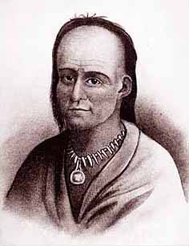
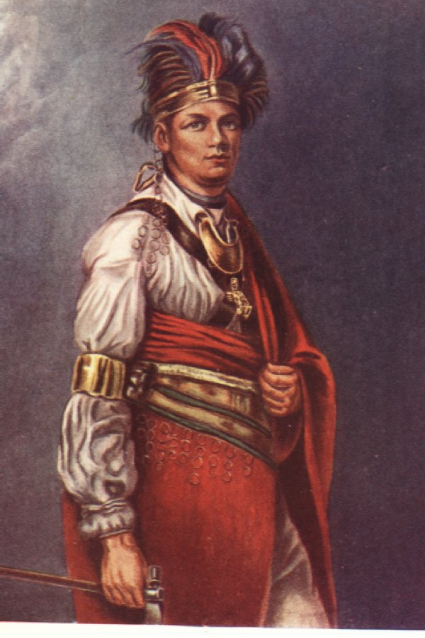
Little Turtle
  War chief of Miami tribe (Ohio valley)
  Led the pan-Indian army to victory over Americans in 1790 and 1791
  Defeated at battle of Fallen Timbers in 1794
    After this becomes a friend of the United States
Joseph Brant
  Chief of the Mohawks
  Sided with Great Britain during the Revolution
  After Treaty of Paris he led a large group of Iroquois people into British Canada
  Establish a separate Iroquois Confederacy

Slide 20
Patriots: supporters of the colonists/Americans
Loyalists: supporters of the British
Treaty of Fort Stanwix: Demands Iroquois/Ohio Indians to give up territory
Cede: “formally” surrender territory
Sovereignty: quality of having supreme, independent authority over a geographic area, such as a territory

Slide 21
Only Americans called for support from Indians during the revolution
  True
  False
Most Indian people…
  Were eager to fight in the Revolution
  Created their own fighting army
  Did not wish to get involved in the Revolution
  None of the above
For what reason did Natives get involved in the Revolution?
  Political independence
  Cultural integrity
  Protection of their land and property
  All of the above
Joseph Brant was a
  British General
  Mohawk Chief
  American Patriot
  French commander
What was the greatest effect of the battle of Yorktown?
  It caused the British to finally grant Americans their independence
  It gave land back to the Indians
  It was an important victory for the British
  It allowed the French to establish an American stronghold

Slide 22
The Treaty of Fort Stanwix called for what?
  The British to reduce the price of imported ammunition
  American forces to give in to British demands
  Iroquois Indians to give in part of their territory to the Americans
  Americans to give back Indian land
Americans treated Indians as conquered peoples after the Revolution
  True
  False
The Northwest Ordinance of 1787 was made to benefit Native Americans
  True
  False
Who were Patriots?
  Supporters of British
  Supporters of Americans
  Supporters of Indians
Little Turtle was a war chief that led attacks against the British
  True
  False

Slide 23
1.B
2.C
3.D
4.B
5.A
6.C
7.A
8.A
9.B
10.B

Slide 24

Faragher, J, Buhle, M, Czitrom, D, & Armitage, S. (2002). Out Of Many. Upper Saddle River: Prentice Hall.

